Slide 1
Learn from cities, and optimize them.
一An overview of data extraction methods in urban environments
Jason Bao

Slide 2

The Problem
Booming population of cities
In 2020, 56.2% of world population was urban
Importance of cities
Economic Prosperities
Social Movements
Backlash of rapid urbanization
Traffic congestion
Air pollution
Overcrowdedness
Unable to solve it efficiently due to limits of data.
Data are useful because of Data Science.
Utilization of data science methodologies to extract valuable urban data, to serve as reference for policy makers to improve city environment.

Slide 3
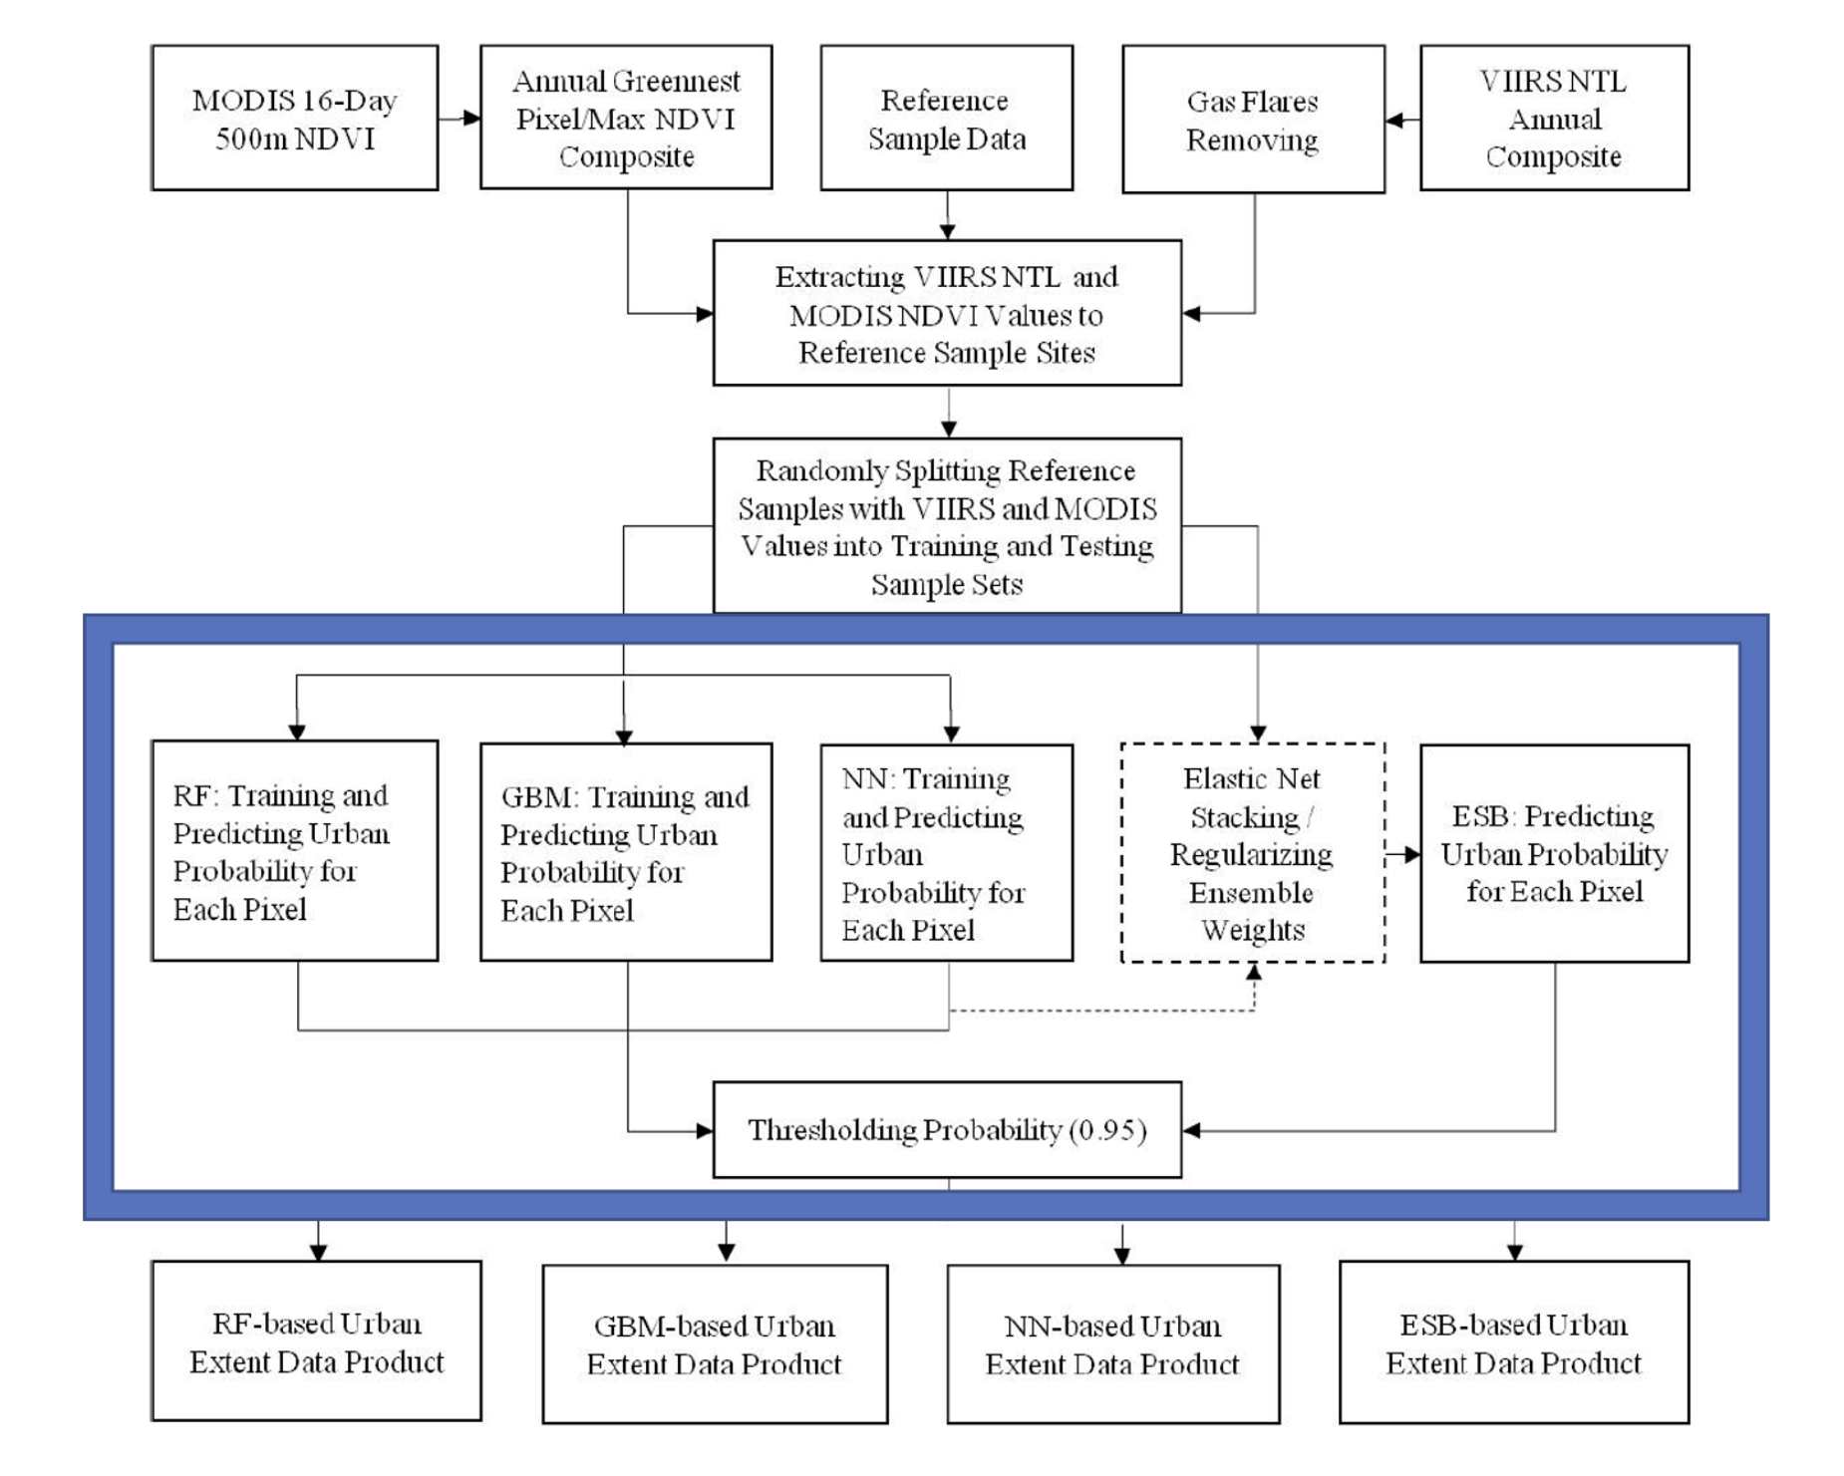
The Methods: Machine Learning
Introduction
Automatically-improved algorithms through experience and by the use of data
Mechanism
Weighted vote of various models
Case Study: Conterminous United States
Objective: large-scale urban extent mapping at an intermediate resolution (500 m)
Outcome & efficiency
Accuracy: >95% from past data

Slide 4
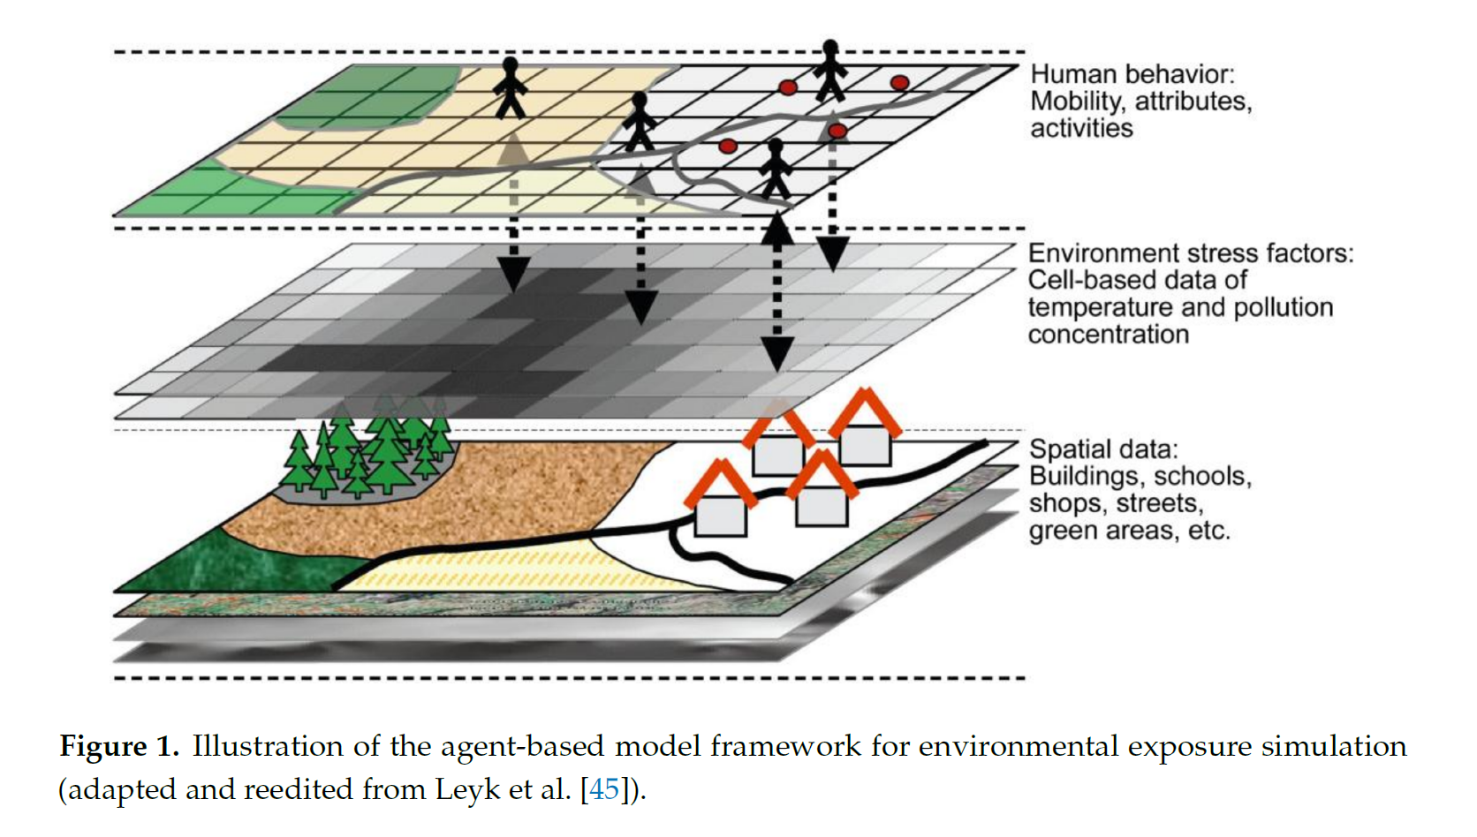
The Methods: Agent-Based Modeling
Introduction
Models for simulating the interactions of autonomous agents
Mechanism
Observe the effects at a higher level
Case Study, Hamburg City
Potential human exposures to environmental stresses (pollutants)
Outcome & efficiency
Offer advice on citizen behaviors after simulations

Slide 5

The Gap & Future
Gap of current methodologies
Verification & Applicability?
Presentation of a board research plan
Integration of the two data science methodologies
Predict & Observe the effects after the implementation of a hypothetical policy
More informed city planners, better policy & infrastructure for citizens
A testable version of city.

